Slide 1
BAE 587 Introduction to R Markdown and use in Homework #5
BAE587, 22 September 2022

Slide 2
Outline of Things to do
Download R
Download R Studio
Read what Markdown is (it is a language)
Read what R Markdown does (purple slides)

Slide 3
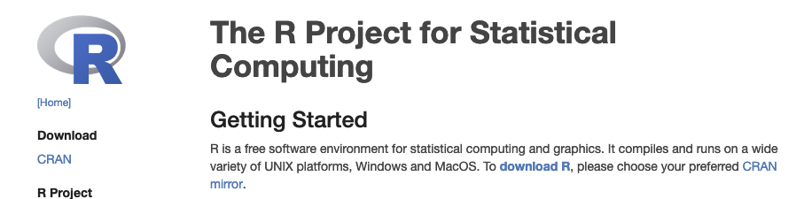
Download R
Google: ‘R project’
http://archive.linux.duke.edu/cran/

Slide 4

Download RStudio
Google: ‘rstudio download’

Slide 5
Using R to make websites, write books and articles
Websites
Articles
Books, chaptered docs

Slide 6
What’s this ***down business?
It starts with Markup language!

Slide 7
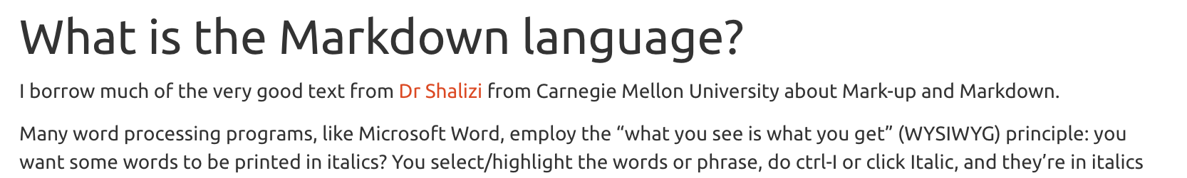
What is the Markup language?
<div id="what-is-the-markdown-language" class="section level2"> <h2>What is the Markdown language?</h2> <p>I borrow ... from <a href="http://www.stat.cmu.edu/~cshalizi/rmarkdown/">Dr Shalizi</a> from ...</p> <p>Many ...that of <em>marking up</em> text. The essential idea in a <strong>mark-up language</strong> is that it consists of ordinary text, <em>plus</em> signs which indicate how to change the formatting or meaning of the text. Some mark-up languages, like HTML (Hyper-Text Markup Language) use very obtrusive markup; others, like the language called <strong>Markdown</strong>, are more subtle.</p> </div>

Slide 8
Markup, Markdown
Play on word!
Markup: a bit on the complicated side (HTML, LaTeX, others)
Markdown: the idea is to make things simple:
<div id="what-is-the-markdown-language" class="section level2"> <h2>What is the Markdown language?</h2>
Becomes
## What is the Markdown language?

Slide 9
One code, several output formats
Markdown .md format recognized by many interpreter codes
Rmarkdown example outputs:
Documents:
Html documents
Pdf document (via LaTeX)
Word document
epub
Presentations:
Ioslides_presentations
Power point presentations
Other:
Interactive dashboards
Github_documents

Slide 10
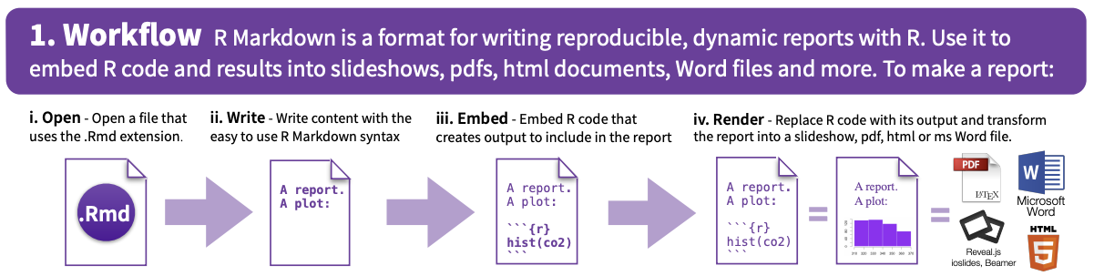
https://www.rstudio.com/wp-content/uploads/2015/02/rmarkdown-cheatsheet.pdf

Slide 11
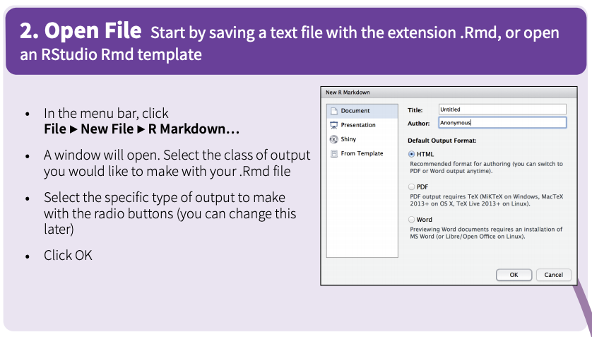

Slide 12
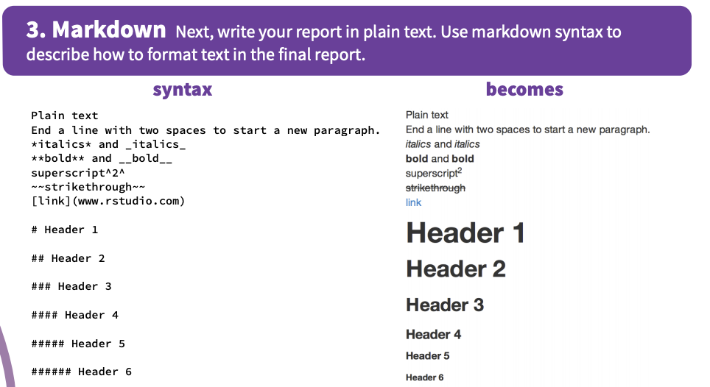

Slide 13
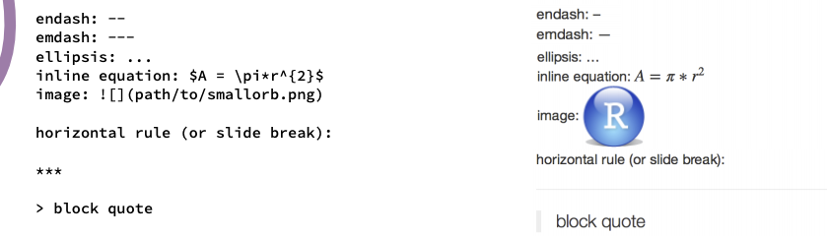

Slide 14
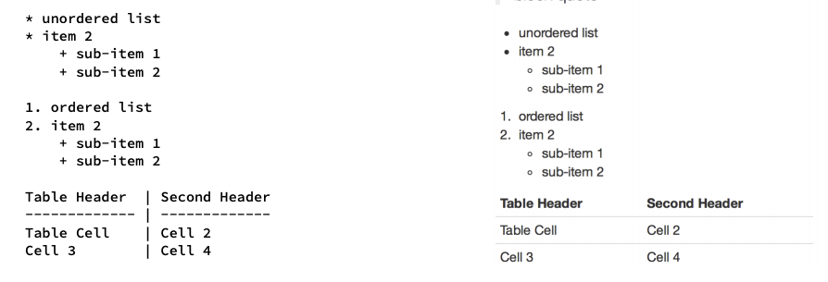

Slide 15
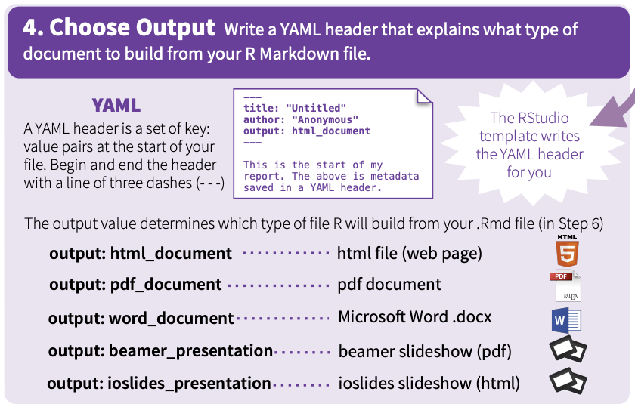

Slide 16
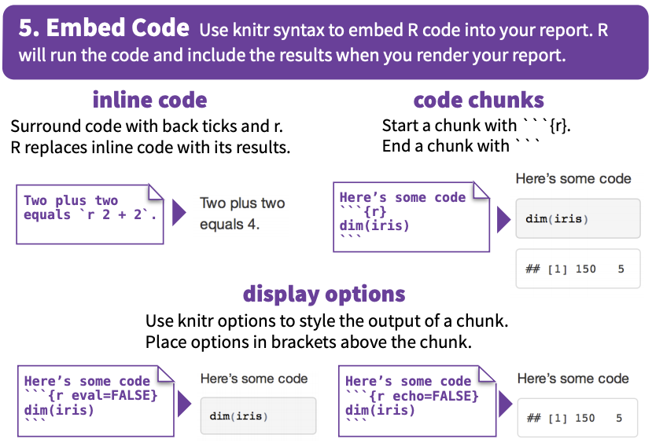

Slide 17
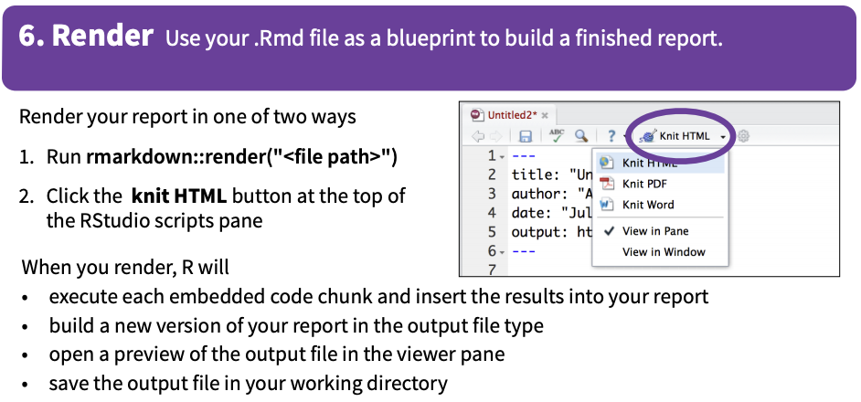

Slide 18
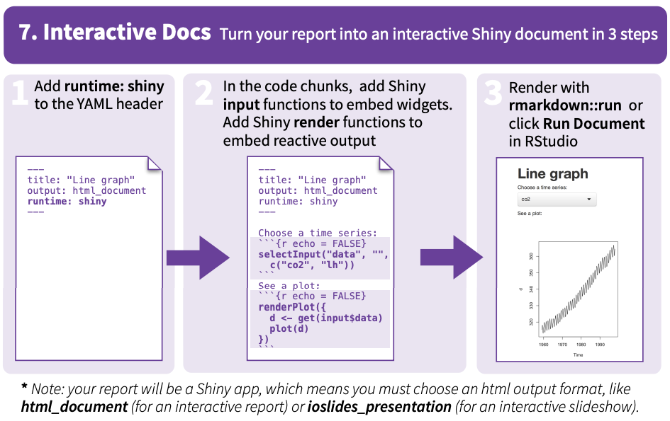

Slide 19
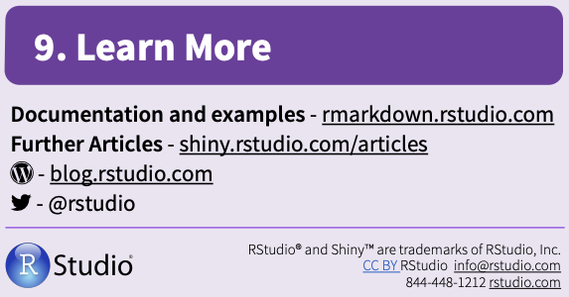

Slide 20
Summaries of what R Markdown is
A nice summary of what R markdown is with available details:
https://rmarkdown.rstudio.com/lesson-1.html
I wrote this one and there are lots of good details in it:
https://francoisbirgand.github.io/tutorial-RMarkdown_instructions.html

Slide 21
The basic structure of an R Markdown document
YAML header
Defines settings for the document
Text
Headings, alteration, cross-references, etc.
Code chunks
Interprets codes in R, python, C, and fortran
Rmarkdown, Bookdown, and blogdown KNIT all pieces together in homogeneous output

Slide 22
And now some practice

Slide 23
Rmarkdown starter
Go to https://github.com/francoisbirgand
Go to repositories
Choose BAE587-QCHmk
(https://github.com/francoisbirgand/BAE587-QCHmk)
Download ZIP

Slide 24
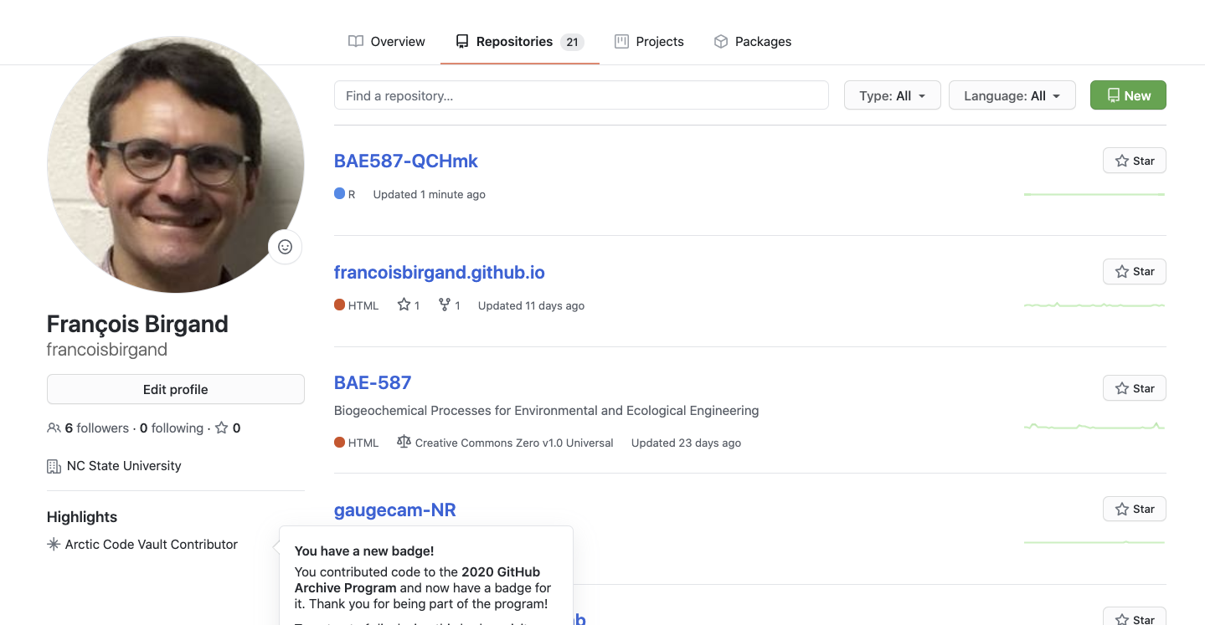

Slide 25
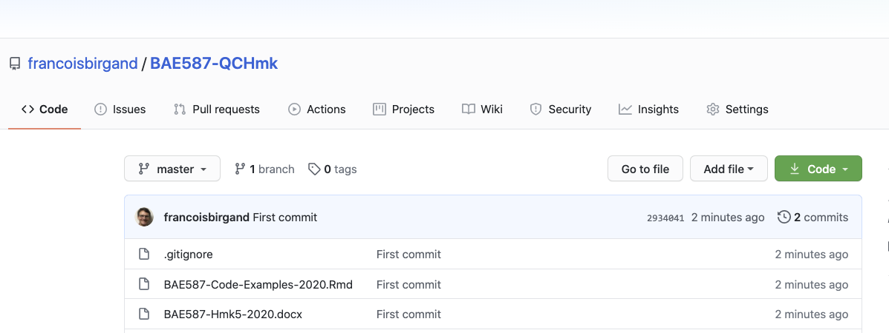

Slide 26
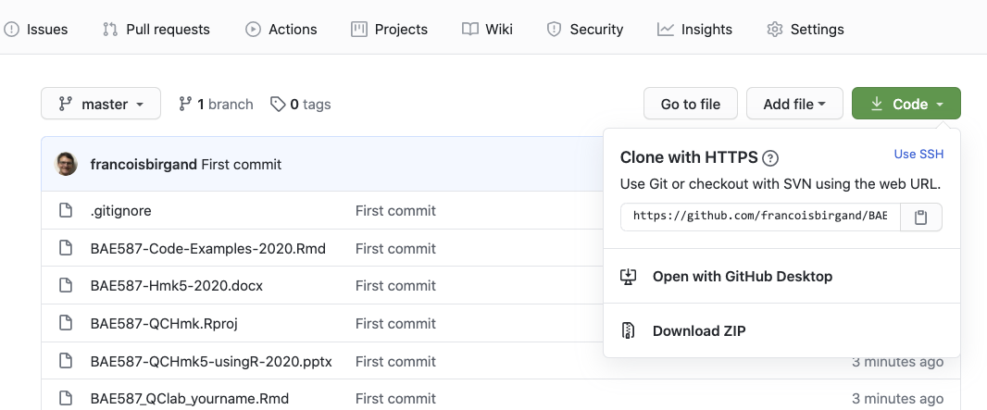

Slide 27
Unzip the file into a directory of your choice
In that directory, open the BAE587-QCHmk.Rproj file
R Studio should open
Normally, your screen should look like on the next slide

Slide 28
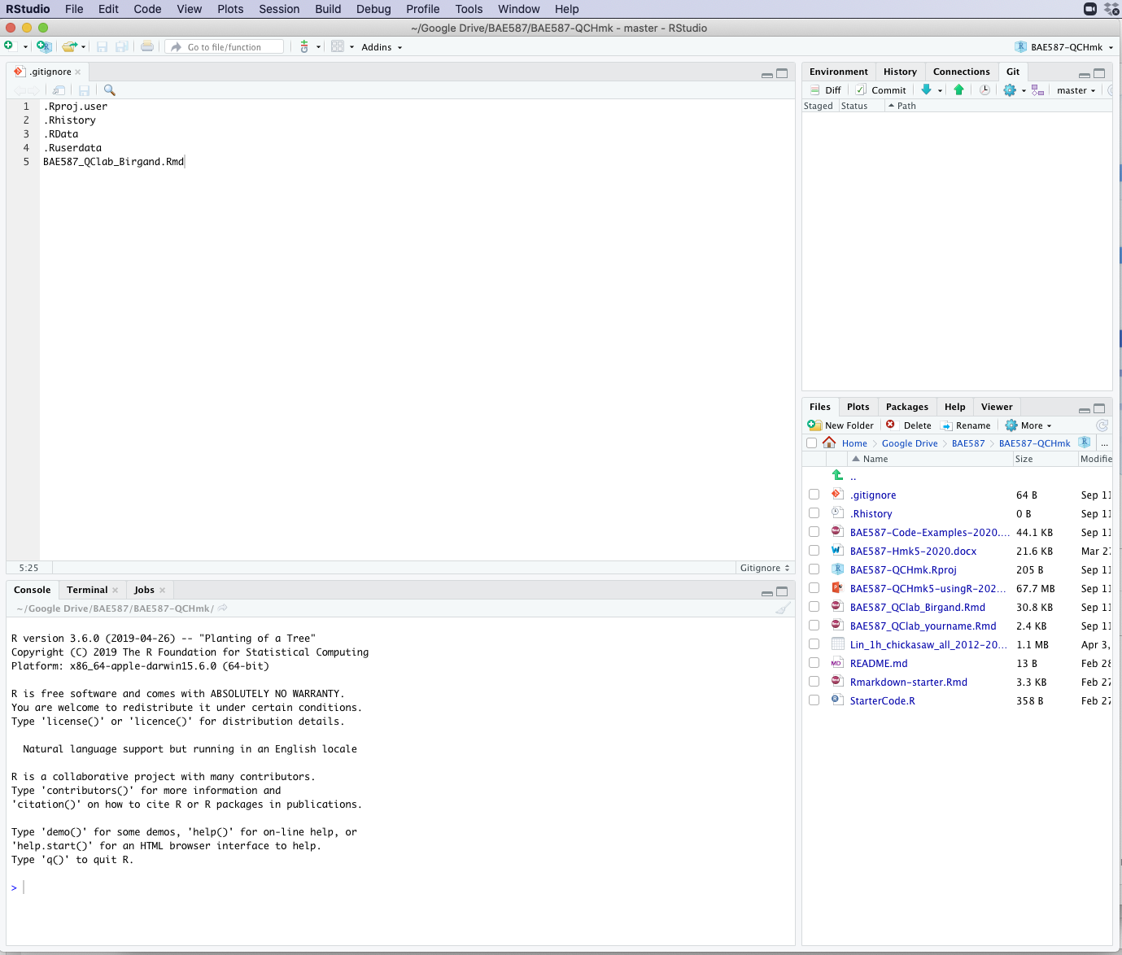

Slide 29
Downloading all necessary packages
In the right bottom window, you can see all the files in your working directory.
You can see several types of files:
*.Rmd: Rmarkdown files, where all your code and text are stored
*.yml: files that define the settings for the book and for the output
*.csv: files where I have data to draw tables
*.bib: files in which the info for cited references is stored
.gitignore: a file in which info of all the files and file types you do NOT want uploaded on Github are stored
*.css: files that define the html output formats
pictures directory: a directory where all the pictures are stored
docs directory: a directory where the all the rendered files are stored and ready for upload in Github
*.R script

Slide 30
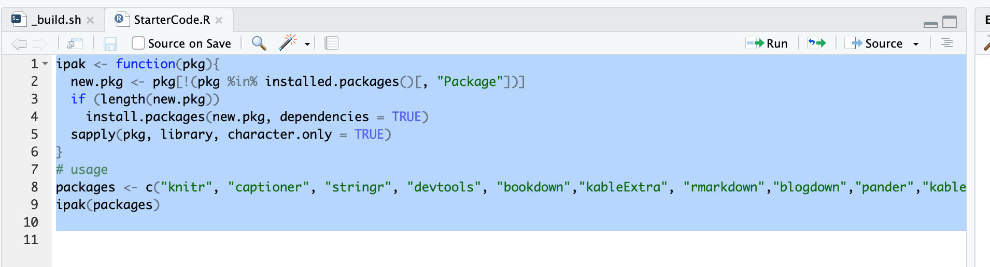
Downloading all necessary packages
Find in that window the StarterCode.R code, click on it
The left panel on the general view is now separated with a console at the bottom, and the file you just opened is at the top
Select all the text and click run

Slide 31
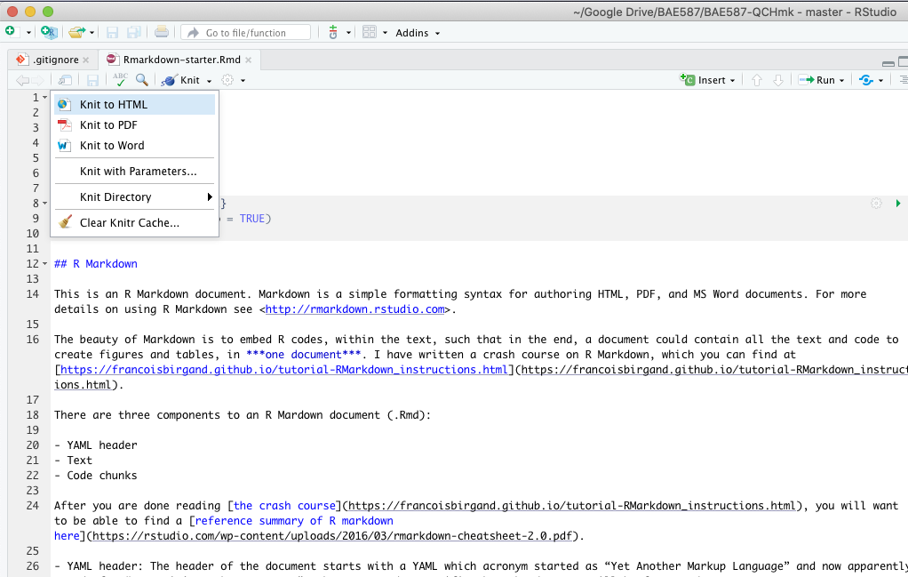
Knit a document
Open Rmarkdown-starter.Rmd
Knit the document

Slide 32
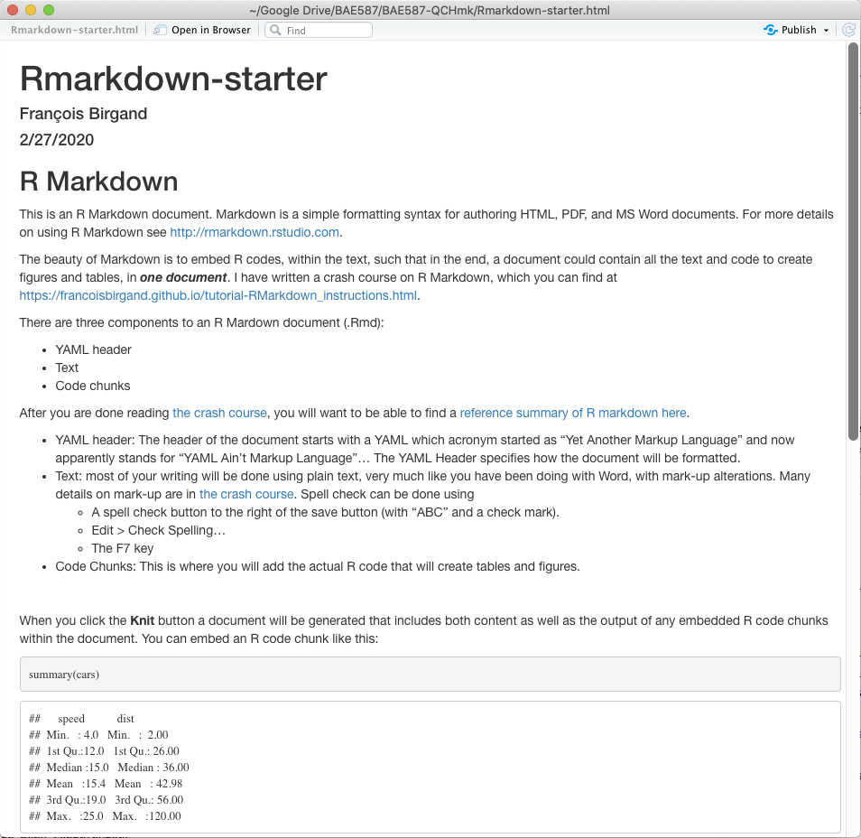
You should obtain

Slide 33
Open ﻿BAE587-Code-Examples-2020.Rmd
Knit it to see what you get
Use this document to mine code as needed

Slide 34
Rename ﻿BAE587_QClab_yourname.Rmd
Rename ﻿BAE587_QClab_yourname.Rmd
Use this document to do the homework
Submit your *.Rmd and *.html rendered document

